Slide 1
Banking web Application
TS- WEB TRACK CAPSTONE PROJECT
Presented By:
1. Masupalli Yuktha Priya – JNTUA College of Engineering Kalikiri(BTech)
Guided By:
R. Uma Maheshwari

Slide 2
OUTLINE
Abstract
Problem Statement
Aim, Objective & Proposed System
System Design
System Development Approach
Algorithm & Deployment
Conclusion
References
Future Scope

Slide 3
Abstract
This Project is aimed at developing an Online Banking for customer. The system is an online application that can be accessed throughout the organization and outside as well with proper login provided.
This application takes input from the user and allows us to carry out almost all banking operations like : Create account, Deposit money, Withdraw money, Check Balance and Transfer money to another account.

Slide 4
Problem Statement
Online banking refers to bank transactions made on the specific bank site by a particular individual in a secure network i.e., without using handcash, we can use the facility of debiting and crediting with the help of login ids and passwords provided by the bank.
The available options available after login are: Account Statement,Withdrawal, Deposit, Current balance and Transfer.
Using the constructs of Postgres SQL Connectivity and all the user interfaces have been designed using React, Express and Nodejs.

Slide 5
Proposed Solution
The basis for the project is to develop a fully automated banking system that includes depositing of amount, withdrawal of amount and exporting the outcome back to the client while considering all the tools and facilities that a client may need for efficient and effective output.
The project has been planned to be having the view of distributed architecture, with centralized storage of the database by means of REST API.

Slide 6
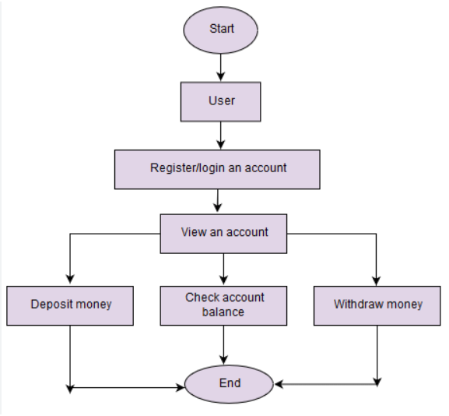
System Architecture

Slide 7
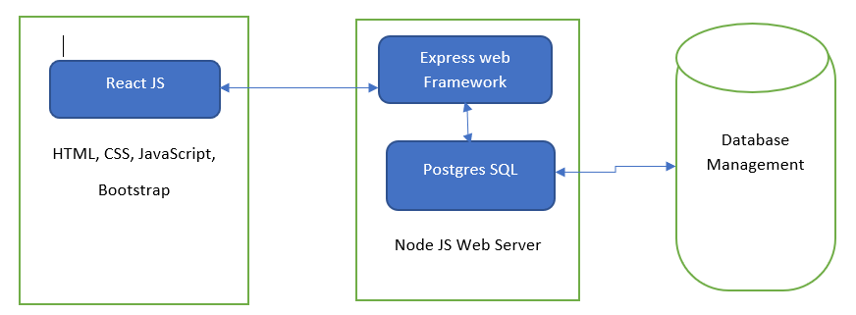
System Deployment Approach
Frontend Development
Backend Development

Slide 8
Algorithm & Deployment
1. To work with PostgreSQL database from Node.js 2. To secure our APIs using authentication 3. To maintain login session until user manually performs a logout 4. To perform CRUD operations in PostgreSQL from Node.js 5. To dynamically generate pdf to get list of transactions within selected date range.

Slide 9
THANK YOU

